Slide 1
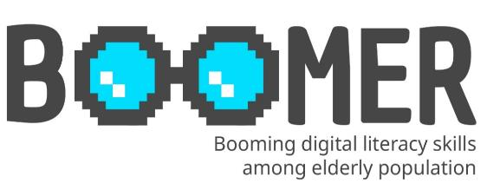

www.digital-boomer.eu
e-Health literacy for the promotion and maintenance of health
Provided by: University of Dubrovnik

Slide 2
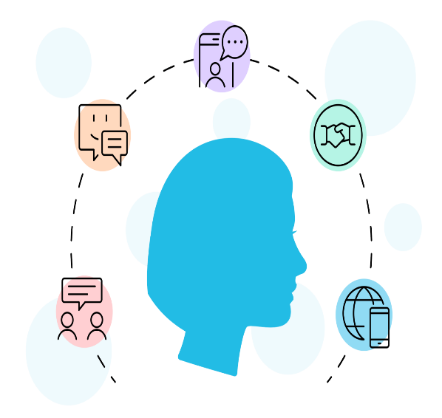
Index
1.1. Definition of health literacy
1.2. Levels of health literacy
1.3. Sources of health information
1.4. e-health literacy
1.5. Connection of health literacy with health and quality of life
1.6. Motives behind disinformation
1.7. The role of social media
Understanding the concept of Health Literacy
1
2.1. Credibility of content - How to identify disinformation?
2.2. How to identify source credibility?
2.3. Ways of checking sources and facts.
2
Identifying health disinformation
3.1. Ways to recognize disinformation in the health field
3.2. Responsible use of online sources of health information
3.3. Responsible online behaviour
3
Responsible
Online Behaviour
https://reemahealth.com/wp-content/uploads/2023/02/HealthLiteracy_Header-1600x1192.png

Slide 3

Objectives
At the end of this module you will be able to:
Understand the concept of health literacy.
Understand the concept of e-health literacy.
Understand disinformation related to health and its impact on individuals.
Develop and improve knowledge and critical thinking skills to identify and evaluate potential health-related disinformation.
Apply basic techniques to verify information using relevant sources.

Slide 4
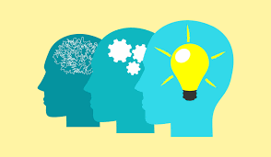
1. Understanding the concept of Health Literacy
https://executiveleader.com/wp-content/uploads/2018/02/understanding-1536x896.jpg

Slide 5
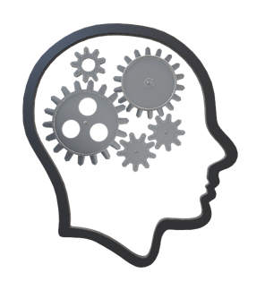


1.1. Definition of Health Literacy
Health literacy encompasses personal, cognitive, and social skills that determine a person's ability to access, understand, and use (medical) information to promote and maintain good health.
Health literacy is sometimes referred to as health information literacy.

Slide 6
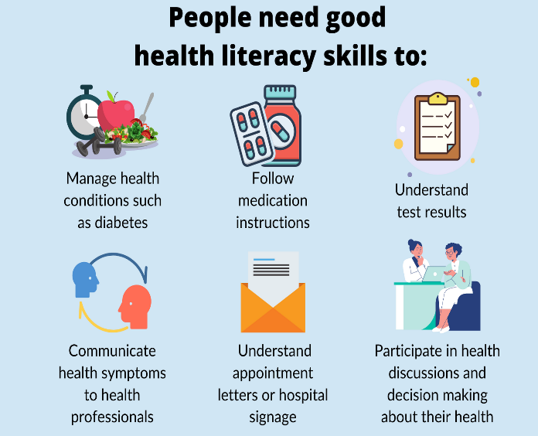
1.1. Definition of Health Literacy
The Medical Library Association (MLA) defines health literacy as:
"a person's ability to recognize the need for information, know where and how to find that information, and use the information to make good decisions about one's health" (MLA).
.
https://infoforwellbeing.scot.nhs.uk/media/1131/why-health-literacy-matters-1.png?width=801&height=568&mode=max

Slide 7
1.2. Levels of Health literacy
Functional health literacy
Interactive health literacy
Critical health literacy
Three levels of Health literacy:

Slide 8
1.2. Levels of Health literacy
Functional health literacy
Encompasses the basic knowledge and skills that enable the effective functioning and management of health care
Anyone in the role of a patient should be able to read and understand medical information
Anyone in the role of a patient should be able to access healthcare services within the healthcare system (e.g. find the service or clinic needed within an outpatient clinic, hospital, etc.)

Slide 9
1.2. Levels of Health literacy
Interactive health literacy
Represents advanced knowledge and skills that enable participation in specific health activities
Understanding of different forms of health information
Understanding of its application in a changing environment
IMPORTANT to remember the rights and responsibilities that everyone has as a potential patient within the healthcare system
Of particular note is the patient's right to informed consent and informed choice (the right to make decisions about their own health and treatment in collaboration with their physician).

Slide 10
1.2. Levels of Health literacy
Critical health literacy
Represents the most advanced knowledge and skills of a health and social nature that enable critical consideration of health information
Improvement of personal and social skills
Understanding of the social, political, and economic levels of health and healthcare system.

Slide 11
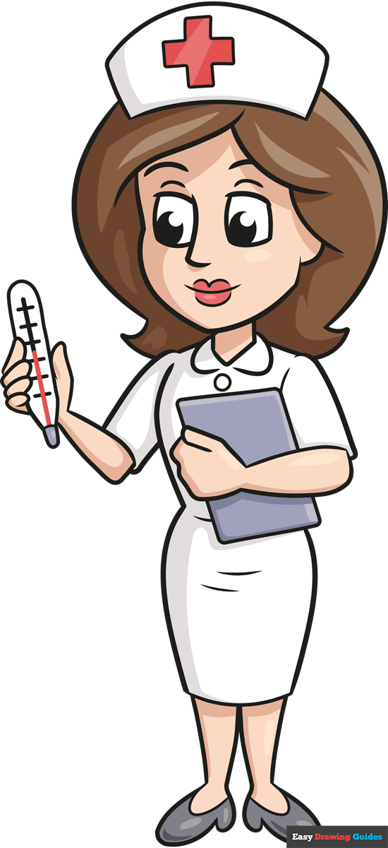

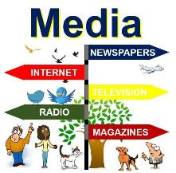
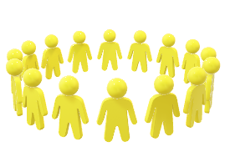
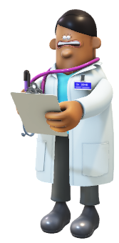
1.3. Sources of health information
There are many sources of health information.
First and foremost is the healthcare professionals – doctors, nurses and other healthcare staff with whom the patient comes into contact
Various printed materials: promotional materials, brochures, magazines, newspapers, books
Media: radio, TV, social networks, e-information - Internet portals
Information from other people: friends, families, associations and patients encountered during the treatment process.

Slide 12
1.3. Sources of health information
Detmer et al. (2003) divide the sources of health information into several groups, depending on how individuals come into contact with the information:
through personal contacts (with family members or friends, physicians, pharmacists, support groups)
through what they hear, see, or read (in sources provided to them by the physician or an institution - brochures or health documentation; in the media; or through education, i.e. courses and workshops)
active search for information (via the Internet, printed sources, patient groups)
E - information, i.e. e-health literacy, is included in the group of active search for health information.
Source: https://firstdraftnews.org/long-form-article/understanding-information-disorder/

Slide 13
1.4. Connection of health literacy with health and quality of life
have more difficult access to health care services
Health literacy is cited as one of the social determinants of health (Rowlands et al., 2017).
Research has shown that people with low health literacy have more difficulty accessing healthcare services, are hospitalized more often, do not follow health recommendations (improper use of medication, non-compliance with dietary plans, lack of exercise, etc.), and are less likely to use preventive protective measures and screenings.
more likely to be hospitalized,
low health literacy
fail to follow health recommendations
less likely to use preventive protective measures and screenings.

Slide 14
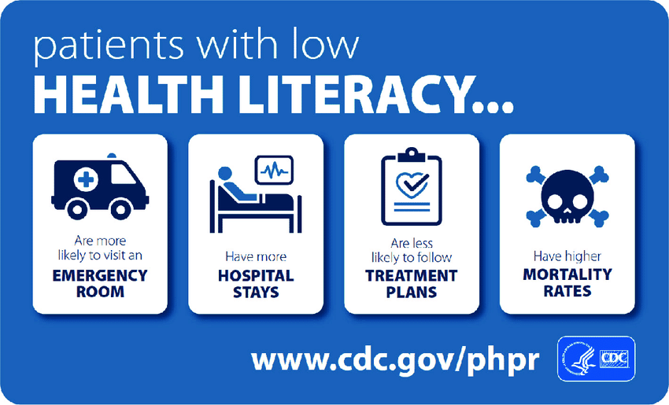
Adverse health outcomes for patients with low health literacy
Centers for Disease Control and Prevention (CDC), Center for Preparedness and Response :Available at: https://www.cdc.gov/cpr/infographics/healthliteracy.htm

Slide 15

1.4. Connection of health literacy with health and quality
of life
poorer health status of the population
more frequent visits to examinations
higher workload for the health system
higher costs
longer hospital stays
more frequent visits to examinations
poorer health status of the population
As low health literacy affects the poor health of individuals, it also places a burden on the social community
Health consequences

Slide 16
1.4. Connection of health literacy with health and quality of life
improved ability to care for oneself
High levels of health literacy are associated with improved ability to care for oneself, control of chronic diseases, greater availability of appropriate health services at lower cost, and better health outcomes, and a reduction in health-related uncertainty (Tardy and Hale, 1998), all of which contribute greatly to independence and a better quality of life.
control of chronic disease
High levels of health literacy
greater availability of appropriate health services at lower cost
the results
better health outcomes
INDEPENDENCE .
BETTER QUALITY OF LIFE

Slide 17
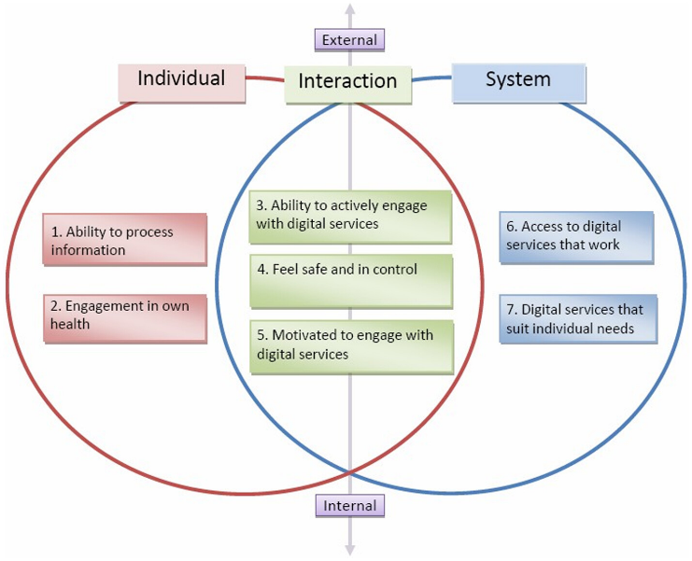
1.5. e-health literacy
The use of information technology for health requires e-health literacy – the ability to read, use a computer, search for information, understand and contextualize health information
e-Health literacy requires an individual's ability to search, find, evaluate, and apply information from the electronic environment to solve a health problem
https://onlinelibrary.wiley.com/cms/asset/bb72cf2d-4135-4fe2-8d7d-3d2641df5bc3/hpja387-fig-0001-m.jpg

Slide 18

1.5. e-health literacy
With the increase in the elderly age group, the demand for training in e-health literacy to better navigate and understand electronic health information has also increased in developed countries
Computer-based electronic health literacy (e-health literacy) is designed to facilitate access to health information, services, and care
An important aspect of searching for health information on the Internet is the active role of individuals in searching for and selecting the desired information
https://www.adiva.hr/wp-content/uploads/2021/09/shutterstock_686237878.jpg

Slide 19
1.5. e-health literacy
development of a strategy for dealing with diseases or specific conditions
acquire new knowledge
correct their health behaviors.
Research among older people has shown that the outcome of searching for health information on the Internet is the development of a strategy for dealing with diseases or specific conditions
that those who use this method of obtaining information believe the content on the Internet
acquire new knowledge
and correct their health behaviour
(Pourrazavi et al., 2020)

Slide 20

1.5. e-health literacy
Content on the Internet is less regulated and more "susceptible" to the marketing of false and unverified information.
Other sources of health information such as books, magazines, or television less "susceptible”
Individuals need to be critical when using public content

Slide 21
1.5. e-health literacy
Information can be divided into false information and disinformation
Information that is published on the assumption that it is correct (published unintentionally) and turns out to be false after some time is called misinformation, while information that is intentionally designed and published with the aim of causing harm or financial gain and turns out to be false is called disinformation
For this very reason, it is necessary to acquire certain knowledge so that the consumption of certain news and information is harmless to the health of the individual
Source: https://firstdraftnews.org/long-form-article/understanding-information-disorder/

Slide 22
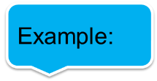
1.5. e-health literacy
Example:
Treatment of varicose veins at home
https://hr4.varcosin.info/azhOwtuQOq/sn9vvMbh5RKAHAz/?al=95218&ap=-1&clickid=w073o9e7n2kjsbhr2c059sbs&esub=-7EBRQCgQAAAPV0gMOZQMCZzfycwHQBgADD_Zl_2QRDRoRDSIRDUIRDVoDSFIHbmwyf2FkY29tYm__NWVLZjhQQnIAA2VJ&site_option=0&sub_2=416&sub_3=noverukavic&sub_4=linker&target=-7EBNQCgQAAAPV0gMOZQAFAQEREQoRCQoRDUIRDRIAAX9hZGNvbWJvATE
Treatment of blood pressure
http://spagetlink.com/tx4f
Example:
Experts Warn Against Inhaling Bleach After Trump Comments
https://time.com/5826882/coronavirus-trump-heat-bleach/
/

Slide 23
1.6 The motives behind Health disinformation
Fake News - Publications refer to intentionally fabricated or false information presented as true for promotional purposes, e.g. to sell a drug, a procedure to treat a particular disease - condition, or for some other reason.
The information includes dangerous Fake News and misleading health information with false claims that can directly endanger lives and seriously harm the health of individuals.
It is important to evaluate the sources, i.e. check the credibility of the information, to avoid fraud, which can have serious consequences in the case of a disease.
It is essential to examine the motive and purpose of the publication.
Source: https://firstdraftnews.org/long-form-article/understanding-information-disorder/

Slide 24
1.6 The motives behind Health disinformation
What could be the motives for Health disinformation?
Selling content - economic gain. - False announcements are usually motivated by financial incentives. Individuals or groups spread false information about a particular product - a drug or therapeutic procedure - to promote it and make a financial gain.
Deliberately causing harm
What can be the purpose of disinformation?
Political basis - manipulation of public exchange (during the Covid 19 pandemic)
Publication with the purpose of publicity (paid advertising)
Source: https://firstdraftnews.org/long-form-article/understanding-information-disorder/

Slide 25
1.7. The role of social media
Social media plays an important role in spreading disinformation, which was especially evident during the coronavirus pandemic and the introduction of quarantine, when social media was the primary source of information
With the spread of the pandemic and the development and introduction of the vaccine against the disease COVID -19, a number of misinformation was spread on Internet platforms about the safety of the vaccine, what to do in case of illness, etc.
One of the examples is that hand washing does not help in fighting COVID -19, as well as advertising a number of "medicines" to treat COVID -19, the use of which can have serious consequences for human health, e.g. "a coronavirus infection can be cured if you drink bleach or pure alcohol".
Source: https://firstdraftnews.org/long-form-article/understanding-information-disorder/

Slide 26
1.7. The role of social media
Social media platforms reinforce and spread disinformation through various content created by users who are not authorised to provide information on health and treatment. For this reason, the European Union and its member states are stepping up their activities and taking measures to combat disinformation.
Available at:
https://www.consilium.europa.eu/hr/policies/coronavirus/fighting-disinformation/
The EU institutions are working to raise awareness of the dangers of disinformation and promote the use of credible sources. To this end, a list of relevant sources of information (official sources of information) in the EU and the relevant EU institutions and international organisations has been published.

Slide 27

1.7. The role of social media
As a result of the activities in the fight against disinformation, a JOINT COMMUNICATION of the EUROPEAN PARLIAMENT, THE EUROPEAN COUNCIL, THE COUNCIL, THE EUROPEAN ECONOMIC AND SOCIAL COMMITTEE AND THE BOARD OF THE REGIONS entitled "The fight against misinformation about the disease COVID-19 - Recognition of the facts” was published in June 2020, in which the European Commission and the High Representative will propose concrete measures to combat the problem of the spread of disinformation.
The document is available at:
(https://eur-lex.europa.eu/legal-content/HR/TXT/PDF/?uri=CELEX:52020JC0008)
The wide reach of social media, as well as the availability of its use, makes it a fertile ground for the rapid spread of false or inaccurate information that can have very serious consequences for the health of individuals.
Source: https://firstdraftnews.org/long-form-article/understanding-information-disorder/

Slide 28
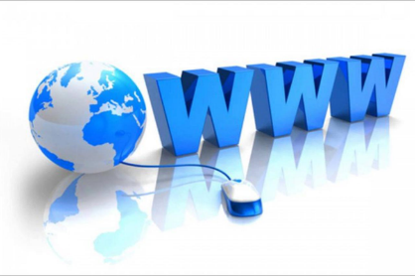
2.
Recognizing health disinformation
https://www.vecernji.ba/media/img/d4/f2/2f8550822c1bff47f6db.jpeg

Slide 29


2.1. Credibility of content - How to recognize health disinformation?
When searching for websites, i.e. posts on internet portals
check the URLs
check if the portal has an imprint
check the identities of the people who edit it

Slide 30
2.1. Credibility of content - How to recognize health disinformation?
The source is credible
if there is an expert, professional person (signed author) behind the publication,
if the sources of the information are actual interlocutors (first and last name)
or relevant healthcare institutions/organisations (primary, secondary, tertiary level of healthcare),
official health portals, i.e. websites
portals of health care institutions, civil society associations, official websites of the Ministry and the Institute of Public Health are
if it can be seen that the information published in a particular medium (Internet portal) is regularly updated (publication date marked).
in advertising, when only positive values are emphasised for a particular product (drug) or service. If it is an article, check the references and their credibility

Slide 31

2.2. How to recognize the credibility of the source?
Check if the website is accredited
Check if the authors and editors are clearly highlighted
Check if the article is signed by the author
Check the references
Check if the site is updated regularly: the date
of the last modification is indicated
Check the grammar
Check the motive and purpose of the publication

Slide 32

2.3. Ways of checking sources and facts
Various criteria can be used to assess the relevance and accuracy of the information found.
checking the date of publication
checking the source,
whether the article is signed by the author,
whether the information can be found on other websites (websites - portals specializing in health),
whether it is an article,
whether the information is supported by quotes - assess the credibility of the quotes,
purpose of the article: whether the article is a paid advertisement or has a political basis.

Slide 33
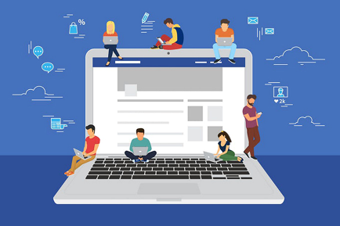
3.
Responsible Online Behaviour
https://www.dijabetes.hr/wp-content/uploads/2023/03/zdravstvena-pismenost-1.jpg

Slide 34

3.1. Ways of recognizing health disinformation
Use accredited websites
websites can be accredited if they meet eight conditions
the authors and publishers are clearly highlighted
it is stated that the website and its content cannot replace a visit to the doctor
user’s data is protected
the website is updated: the date of the last modification is indicated,
the information is objective and complete
the interface of the website is accessible to the user and has a highlighted task
all sources of funding are clearly indicated
all advertisements must be marked as advertising so that the reader can distinguish them from the health content of the website
search for specialized websites whose content is focused on health prevention and disease prevention, as well as websites - portals where one can get answers to health-related questions.
https://images.fineartamerica.com/images-medium-large-5/blue-exclamation-point-button-henrik-lehnerer.jpg

Slide 35
3.1. Ways of recognizing health disinformation
Examples of accredited websites:
https://www.hzjz.hr/
https://stampar.hr/hr
https://eurohealthnet.eu/
https://www.who.int/
https://united-healthcare.eu/
https://www.iss.it/web/iss-en
https://www.sciensano.be/en/health-topics

Slide 36
3.2. Responsible use of online sources for health information
A responsible approach to the world of the Internet, in this case health information, requires following a few rules.
Review information before sharing or using it with others.
Look for reliable sources and ask a professional (doctor, nurse/technician) to confirm the accuracy of the information.
Objectively assess the credibility of content and consider alternative perspectives before using or sharing information.
Verify the credibility of sources by looking for evidence and checking claims, especially in cases of "miracles" and easy solutions in treating and curing certain conditions and diseases (e.g. chronic diseases, diabetes, arthritis, etc.), which calls into question the veracity.
Look for other sources to educate yourself and better understand the topic (disease, condition)

Slide 37
3.3. Responsible online behaviour
Verify information before using or sharing it: Verify the authenticity and credibility of information from trusted sources or fact-checking organizations (medical professionals, specialized health care facilities, etc.) before sharing it
Use trusted - specialized sources: Rely on trusted sources of health information to avoid misinformation. Follow specialized fact-checking websites and experts in various health fields
Fact-checking and analysis-Develop critical thinking skills by reviewing the information you find. Assess the credibility of the source, examine the evidence

Slide 38
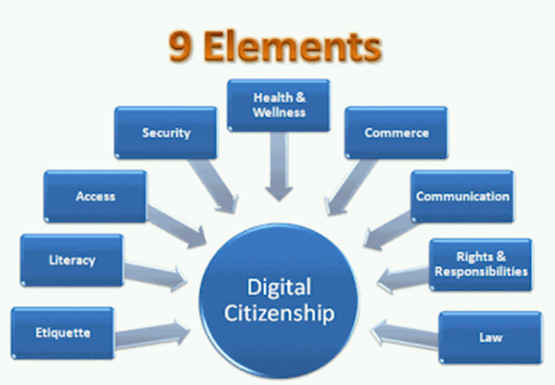
3.3. Responsible online behaviour
Use fact-checking tools: Use fact-checking tools and resources available on the Internet to verify the accuracy of claims – search for other specialized websites - sources to verify stated health-related facts.
Report and point out disinformation: If you come across false or inaccurate information, report it to the platform or social network where it can be found.
Guidelines for responsible, appropriate, behaviour in using technology
https://sites.google.com/a/uconn.edu/internet-safety-101/_/rsrc/1406055561420/digital-citizenship/Nine%20Elements%20of%20Digital%20Citizenship.gif?height=286&width=400

Slide 39

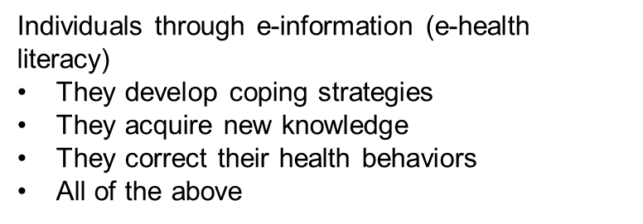
Test your knowledge!
:
Functional health literacy represents:
The most advanced knowledge and skills of a health and social nature that enable critical consideration of health information, improvement of personal and social skills, and understanding of the social, political, and economic levels of health and health.
Advanced knowledge and skills that enable participation in specific health activities, understanding of various forms of health information and its application in a changing environment.
Basic knowledge and skills that enable effective functioning and management of the health environment
The most important aspect of searching for health information on the Internet is:
The active role of the individual in searching for and selecting the desired information
The development of a disease management strategy
The correction of health behaviour
All of the above
High levels of health literacy are associated
with:
Better ability to care for oneself
Better management of chronic diseases
Better quality of life
All of the above
How can you verify the credibility of a source?
Verify the identity of the people editing the source.
Check URLs
Check if the portal has an imprint.
All of the above options

Slide 40
Bibliography
Pourrazavi, S., Kouzekanani, K., Bazargan-Hejazi, S., Shaghaghi, A., Hashemiparast, M., Fathifar, Z., & Allahverdipour, H. (2020). Theory-based E-health literacy interventions in older adults: a systematic review. Archives of Public Health, 78, 1-8.
Rowlands, G., Shaw, A., Jaswal, S., Smith, S., & Harpham, T. (2017). Health literacy and the social determinants of health: A qualitative model from adult learners. Health Promotion International, 32(1), 13-138. https://doi.org/10.1093/heapro/dav093
Coughlin, S. S., Stewart, J. L., Young, L., Heboyan, V., & De Leo, G. (2018). Health literacy and patient web portals. International journal of medical informatics, 113, 43-48.
Burkhardt, J. Truth, Post-Truth, and Information Literacy : Evaluating Sources. // Information literacy and libraries in the age of fake news / Denise E. Agosto. Santa Barbara; Denver : Libraries Unlimited, 2018, 94-105.
Ecker, U. et al. Do People Keep Believing Because They Want To? : Preexisting Attitudes and the Continued Influence of Misinformation. // Memory & Cognition 42, 2(2014), str. 292-304. Dostupno na: https://www.researchgate.net/publication/255950545_Do_People_Keep_Believing_because_They_Want_To_Preexisting_Attitudes_and_the_Continued_Influence_of_Misinformation (20.8.2023.).

Slide 41
Bibliography
A. (2006). eHEALS: the eHealth literacy scale. Journal of medical Internet research, 8(4), e507. https://pubmed.ncbi.nlm.nih.gov/17213046/
Chung, S. Y., & Nahm, E. S. (2015). Testing reliability and validity of the eHealth Literacy Scale (eHEALS) for older adults recruited online. Computers, informatics, nursing: CIN, 33(4), 150.
De Brún, C. Health literacy and health information literacy, and the role of librarians. Knowledge for Healthcare. 2019. Dostupno na: https://kfh.libraryservices.nhs.uk/health-literacy-and-health-information-literacy-and-the-role-of-librarians/ (20.8.2023.).
Detmer, D. et al. The Informed Patiend : Study Report. Cambridge University Health, 2003. Available at: https://citeseerx.ist.psu.edu/viewdoc/download?doi=10.1.1.471.7791&rep=rep1&type=pdf (15.1.2021.).

Slide 42

www.digital-boomer.eu
Thank you for your attention!

